Slide 1
Organization and planning of scientific research
Lection #5
Zholaman Bektemessov

Slide 2

How to Make a Good Scientific Report

Slide 3
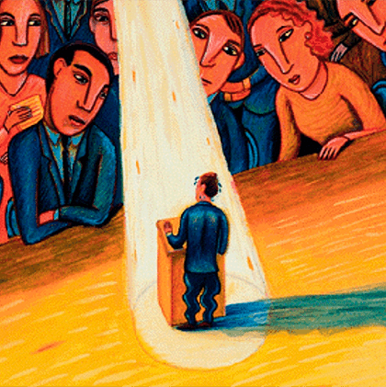
An inexperienced speaker, finding himself under the close attention of the public, often gets confused and performs in a way that is not at all what he would like.

Slide 4

Anyone can make a good report
Everyone can improve their presentation technique.
All scientists should know the basics of giving good talks. This will benefit both the speaker and the audience.
The proposed approach includes both elements of theatrical art and principles of oratory.
The purpose of these principles is not marketing - it is not to put a shine on an essentially useless product.
The point of this approach is to give people an idea of ​​the importance of your work, to show it as you see it.

Slide 5
Three Basic Principles of a Good Report
Preparing slides: each slide should have its own full title;
Presentation: Make eye contact with the audience, look out into the room, not at the screen;
Questions: Listen to the question, repeat it. Remember, the main thing in a question is its content, not the tone in which it was asked.

Slide 6
Preparation of the report
Preparing a good report should begin with finding a concise and accurate title for the presentation.
This should be done before you start preparing your slides.
Come up with a name yourself.
It should describe the topic and purpose of the report in one sentence.

Slide 7
Example of a title
For example, the title might be: “Optimal Methods for Solving Partial Differential Equations on Unstructured Meshes.”
Here's an example of what not to call it: "Solving partial differential equations."
Why?
Because this sentence is not finished, its meaning is not complete.
The title is your guide: it will tell you what to include in your presentation and what to leave for next time.
The report should contain only those materials that relate to the title.
Do not include dry (albeit interesting) data in your report unless it is relevant to the topic.

Slide 8
Slide Title
Now that you have an overall title, expand on it through a series of subheadings on individual slides that gradually lead the listener to the essence of the message.
Remember that each slide should have its own title.
Following one after another, these headings should form a coherent logical chain.

Slide 9

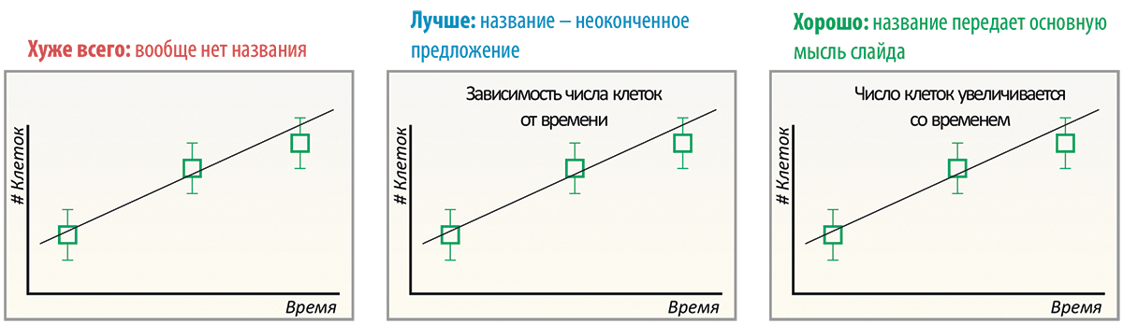

Slide 10
Title of the report
Coming up with a title for a report and headings for each slide is not easy.
However, these efforts should be considered an integral part of your research; this will help you focus on what is important and relevant and identify any missed points.
The title will also help make your slides easy to understand: each slide should contain only what is actually essential.
If a slide contains two titles - two important ideas - it is better to split it into two slides.
There shouldn't be too much experimental data; otherwise the title could be changed to "I'm going to impress you with the fact that I've done a lot of work."

Slide 11
Duration of the report
As you prepare for your presentation, memorize the first two or three sentences of each slide.
Learn the text of the report: practice it until you have it memorized.
Calculate the length of your presentation so that you finish before the allotted time - and never drag it out!
It would be ideal if you timed your speech so that it would fit into 2/3 of the allotted time.
For example, if you have 60 minutes to present, plan for 40 minutes, or 20-30 slides.

Slide 12
Introductory part
It is very important to correctly construct the introductory part at the beginning of the report.
Remember that there is a lot your audience doesn't know, and they will appreciate hearing things that are known and obvious.
Therefore, you must introduce your listeners to the problem gradually, moving from the simple to the increasingly complex, from general concepts to the specific problems of your work.
This will help the audience understand you, and it will ensure that you keep your listeners’ attention..

Slide 13
Presentation
A good presentation is a two-way communication with the audience. Therefore, the first thing you need to do is establish eye contact with your listeners.
Don't bury yourself in your slides - this is a sign of fear and insecurity in front of the audience. As during theatrical performances, the audience sympathizes with the "hero" and identifies with the speaker. In fact, the listeners themselves are interested in the report being interesting.
If you “disconnect” from the audience and focus only on the slides, then they will stop following your presentation.
And when you make eye contact and engage your audience, they respond in kind.

Slide 14
Eye contact
Eye contact gives you the opportunity to understand the state of your listeners and adapt to subtle changes in their mood.
If you feel like your audience is losing attention, change your tone or gestures, pause, or say something you feel right now, like: “It’s getting hot,” or “I can smell the coffee,” whatever it is, but something that most people in the room are feeling.
Such a break will allow you to rest and restore broken contact.

Slide 15
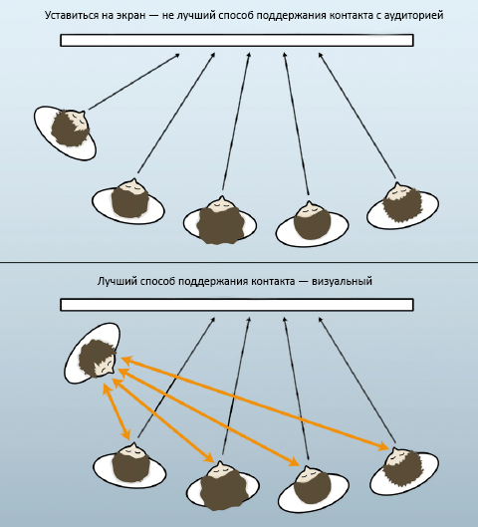
Staring at a screen is not the best way to maintain contact with an audience.
The best way to maintain contact is visual.

Slide 16
The speech as a fascinating story
Once you have some experience in scientific public speaking, start turning your formal presentation into an engaging story.
Tell us the story of what observation led to your work and what your first steps were.
Remember how the tension grew in anticipation of the discovery. And finally, the flash: “Ah, here is the answer.”
A well-presented popular story about the origin, development and solution of a problem is often more informative than the dry language of facts.

Slide 17
Body language
Body language is also important for communication. It is very common to see a speaker in a distorted posture: his shoulders are turned towards the audience, his eyes are fixed on the slides, he has a laser pointer in one hand and a slide selector in the other.
This is a “defensive” sign language that worsens contact with the audience and increases the tension of the speaker himself.
Make a short video recording of your presentation and you will see what is being discussed.
Over time, most people find their own “open” body language, and this helps them feel more relaxed during a presentation.
And the sooner you practice your style, the more productive your future presentations will be.

Slide 18
Also, remember that you are responsible for ensuring that your audience understands the essence of your work.
Avoid using questions like: “Do you understand? Is everything clear to you?”
Ask, “Did I explain myself clearly?” – this way you place the responsibility for clarity of presentation directly on yourself and free slightly distracted or tired listeners from the burden of latent reproaches..

Slide 19
How to answer questions
Questions are a unique opportunity to gain insight from experts and the wider audience about your work.
Although many consider questions from the audience to be analogous to student exams and answer too briefly, wanting to get it over with as quickly as possible.
Here are some tips to help you relax, understand questions, and answer them expressively.

Slide 20
First, don't forget to make eye contact with the people asking questions.
Second, repeat the question in the same words so that everyone can hear it (often the microphones on stage and in the audience are adjusted differently, and other listeners may not understand or hear the question).
This will also give you extra time to better understand the meaning of what is being said.
Check your opponent’s reaction to see if you understood the meaning of the question, and if not, don’t be shy about asking them to explain again or rephrase the question (this is especially important if the question is not asked in your native language).

Slide 21
Listen to the question: We often start answering immediately after the first two words, as if we expected exactly this reaction. But this is often how we can get into trouble.
Now that you have been asked a clear question, agree that the question is worthwhile. Say “yes” to the idea itself, because every idea has the right to exist and be discussed.
You can honestly admit: “I don’t know” , “I haven’t thought about that before” , “let’s talk about that after the lecture” , or “that’s a very accurate observation”.

Slide 22
The emotional mood of the question
Unfortunately, some questions at scientific presentations are asked in an unmotivatedly aggressive tone.
Here it is important to separate the dramatic presentation – the “music” (emotional mood) of the question – from the content.
Asking a question aggressively can trigger an intuitive defensive reaction, and you will not understand the meaning of what was asked.
If you separate aggression from the content, you have a chance to respond correctly while not testing the patience of those present.
This will both reduce aggression to zero and give you points.

Slide 23
The first question is very important because the way you answer it will set the tone of the discussion that follows.
It is the beginning of this part of your speech that you should devote the most time and attention to.
And of course, be sure to take all the questions asked into account when preparing for your next presentation (start again with the preparatory phase).
This way, you will prevent the same questions from appearing over and over again and will be able to move on to the “next level” questions.

Slide 24
Overcoming stage fright
If you are worried about how to give a presentation, if you are worried and anxious, then you are not alone.
Most people have a fear of the audience: the fear that the audience will not understand you or will find errors in your work, and you will be thrown out of the scientific community in disgrace.
Fear is the terrible feeling that comes from “over-preparing”—duplicating every word on your slides and presenting unnecessary data.
Perhaps the only positive role of fear is that in this case experienced listeners will feel sorry for you and will encourage you.
However, it can no longer be called a success.

Slide 25
Guide for the audience
One of the best ways to overcome stage fright is to imagine that you are a guide, holding each listener's hand as you lead them through a compelling story.
Be careful to make sure no one falls behind.
If you have friends in the audience, imagine that you are simply talking to them, and gradually people gather around you who also want to listen.
Gradually you will involve the entire audience in the conversation.

Slide 26
Don't be shy about working it out
Don't be shy about practicing these simple techniques at any presentation, and I promise you that gradually your presentation preparation will reach a qualitatively new level, and reports and seminars will turn into a pleasant pastime (even for you ;-).

Slide 27
Some important details (1/2)
The speaker must be fluent in the material. It is not enough to learn two sentences. You just need to know what you are talking about.
There are many techniques for holding the audience's attention. The simplest and most effective is to evoke strong emotions in the audience.
Perhaps you can refute some established dogma or present an alternative point of view, even if it is absolutely fantastic, but one that should focus attention on what you are going to say.
The presentation should be dynamic and attention-grabbing.

Slide 28
Some important details (2/2)
5. You need to allow the audience to relax - don't overwhelm them with a continuous stream of numbers, add a little humor or switch to a quote from a famous movie for a second (there can be many techniques).
6. Provide compelling arguments (which you believe yourself :-)
7. Any report requires a summary.
8. At the end of the report, you need to evoke positive emotions in the audience. Just show a funny unusual picture that will make the audience smile.
these are just a few tips, and of course the most important thing is
"... and experience, the son of mistakes..."

Slide 29
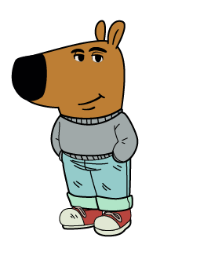
References
I am just a chill guy who used the materials from an essay by Israeli scientist Uri Alon, published in the journal Molecular Cell.

